Slide 1

Meltdown and Spectre
Exploiting critical vulnerabilities in modern processors
Operating Systems for Embedded Systems
Prof. Di Carlo Stefano
Davide Giuffrida - s310265
Matteo Fragassi - s317636
Elena Roncolino - s304719
Umberto Toppino - s277916

Slide 2

License Agreement
This presentation is licensed under the Creative Commons BY-NC License
To view a copy of the license visit:
https://creativecommons.org/licenses/by-nc/4.0/
Please credit the original authors

Slide 3


Outline
What are Meltdown and Spectre
How does Meltdown work?
What about Spectre?
Our implementation
Conclusions
Figures taken from: https://meltdownattack.com/

Slide 4


What are Meltdown and Spectre
Hardware vulnerabilities affecting a wide range of modern processors
Meltdown:
Breaks the most fundamental isolation between Operating System and application
Allows an attacker to access the memory of other programs and the Operating System
Spectre:
Breaks the isolation between different applications
Allows an attacker to trick a error-free application into leaking its secrets
Figures taken from: https://meltdownattack.com/

Slide 5
What are Meltdown and Spectre
They exploit three of the major designs of modern processors:
Out-of-order Execution
Speculative Execution
Caching

Slide 6
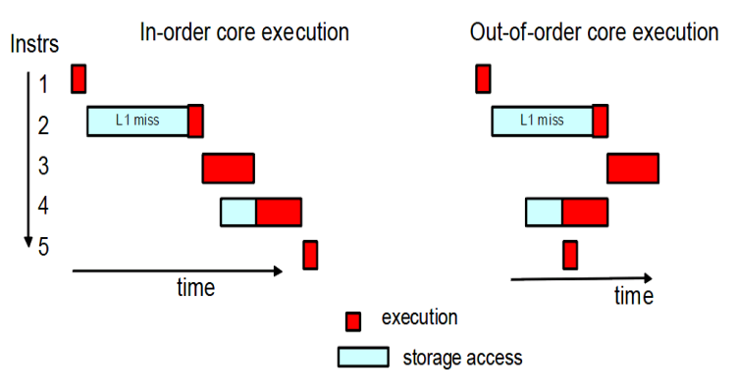
What are Meltdown and Spectre
They exploit three of the major designs of modern processors:
Out-of-order Execution
Speculative Execution
Caching
The processor executes the program instructions not in the order in which they appear, but in the order that is more convenient and that best exploit the resources.
Figure taken from: http://zseries.marist.edu/pdfs/ztidbitz/28%20zNibbler%20%28z196%20O-O-O%20Execution%29.pdf

Slide 7
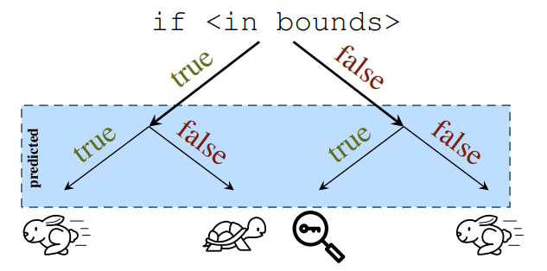
What are Meltdown and Spectre
They exploit three of the major designs of modern processors:
Out-of-order Execution
Speculative Execution
Caching
The CPU may execute certain tasks ahead of time, "speculating" that they
will be needed. If the tasks are not required, their changes are reverted to the previous state.
Figure taken from: https://meltdownattack.com/

Slide 8
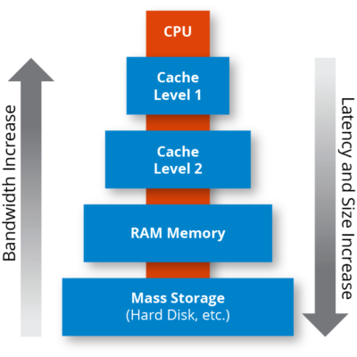
What are Meltdown and Spectre
They exploit three of the major designs of modern processors:
Out-of-order Execution
Speculative Execution
Caching
A small and fast memory (the cache) stores data frequently accessed by the CPU. Exploits temporal and spatial locality to speed up the data access and program execution.
Figure taken from: https://hazelcast.com/glossary/memory-caching/

Slide 9
How does Meltdown work?
Meltdown exploits out-of-order execution to execute instructions acting on data outside of legal memory before an exception is raised
It can be divided in three steps:
Step One: A memory location inaccessible by the attacker is loaded into a register
Step Two: A transient instruction accesses a cache line based on the previous data
Step Three: The attacker determines the accessed line and retrieves the secret data

Slide 10
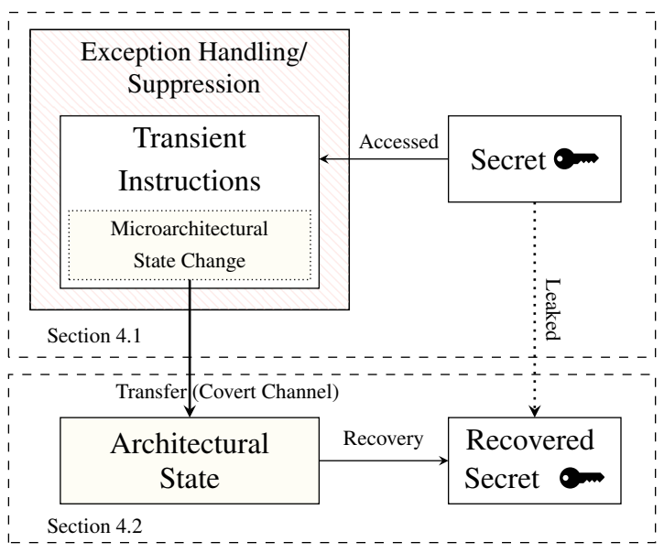
How does Meltdown work?
Following the previous three steps, Meltdown can access all data locations in memory, leaking information it shouldn’t have access to.
The transient instructions act as a covert channel to transfer the data from the kernel memory to the attacker
Figure taken from: https://meltdownattack.com/meltdown.pdf

Slide 11
What about Spectre?
Spectre can be implemented in two different variants:
Exploiting conditional branch misprediction
Poisoning indirect branches
Both variants follow the same general steps:
Setup: mistraining of speculative predictions
Transfer: access secret data exploiting speculative (mis-)execution
Recovery: monitor cache access times to retrieve the secret data

Slide 12

Spectre: Variant 1
The first variant exploits conditional branch misprediction: let’s consider an example with the code above:
x is an integer received from an untrusted source
array1[] is an array of bytes of size array1_size
array2[] is an array of bytes of size 1MB
Figure taken from: https://spectreattack.com/spectre.pdf

Slide 13
Spectre: Variant 1
Phase One: the Setup
Previous operations receive valid values of x, leading the branch predictor to assume that the if statement will likely be true
array1_size and array2 are uncached
The value of x is maliciously chosen so that array1[x] resolves to a secret byte k in the victim’s memory
The secret byte k is cached
Figure taken from: https://spectreattack.com/spectre.pdf

Slide 14
Spectre: Variant 1
Phase Two: the Execution
The processor tries to compare x and array1_size causing a cache miss since array1_size is not present in cache
While waiting for array1_size’s value, the branch predictor executes the following line assuming that the if statement will be true
The CPU requests array1[x] which returns the secret k
array2[k*4096] is requested affecting the cache in a way that depends on the value of k
Figure taken from: https://spectreattack.com/spectre.pdf

Slide 15
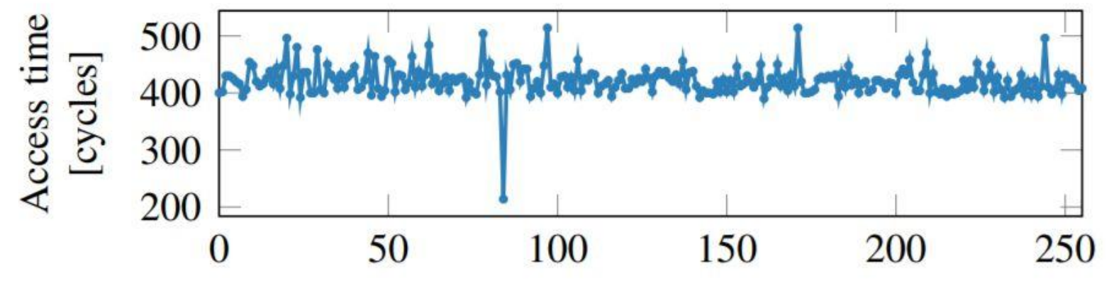
Spectre: Variant 1
Phase Three: the Recovery
Although the code execution resumes normally reverting the changes of a wrong branch prediction, the cache state remains affected!
By measuring access times of array2’s data it’s possible to identify the cached data at address array2[k*4096]
Figure taken from: https://spectreattack.com/spectre.pdf
Figure taken from: https://meltdownattack.com/meltdown.pdf

Slide 16
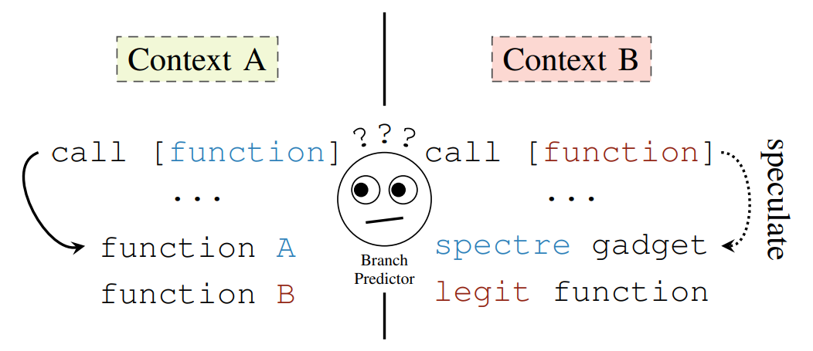
Spectre: Variant 2
The second variant exploits indirect branch poisoning
Indirect branching: jumping to code at some arbitrary location:
jmp[eax] : jump to instruction stored at the address in register EAX
As shown in the above picture, the mistraining in contex A brings the CPU to speculatively execute a malicious function in context B
Figure taken from: https://meltdownattack.com/meltdown.pdf

Slide 17
Spectre: Variant 2
Phase One: the Setup
A suitable function, called gadget, is selected: it will allow the secret data to be leaked (similarly to variant 1)
The branch predictor is mistrained by repeatedly supplying the address of the Spectre gadget
Figure taken from: https://meltdownattack.com/meltdown.pdf

Slide 18
Spectre: Variant 2
Phase Two: the Execution
Assuming a gadget made up of just two instructions utilizing two registers R1 and R2
The secret data k is added to the value of R1 and stored in R2
R2 is used to access the memory address in R2
The data stored at address R2 is loaded in cache
Figure taken from: https://meltdownattack.com/meltdown.pdf

Slide 19
Spectre: Variant 2
Phase Three: the Recovery
The content of the cache remains affected by the misprediction even after the correct execution resumes
By measuring access times of the cache, it’s possible to identify the affected memory location and retrieve the value of the secret k
Figures taken from: https://meltdownattack.com/meltdown.pdf

Slide 20
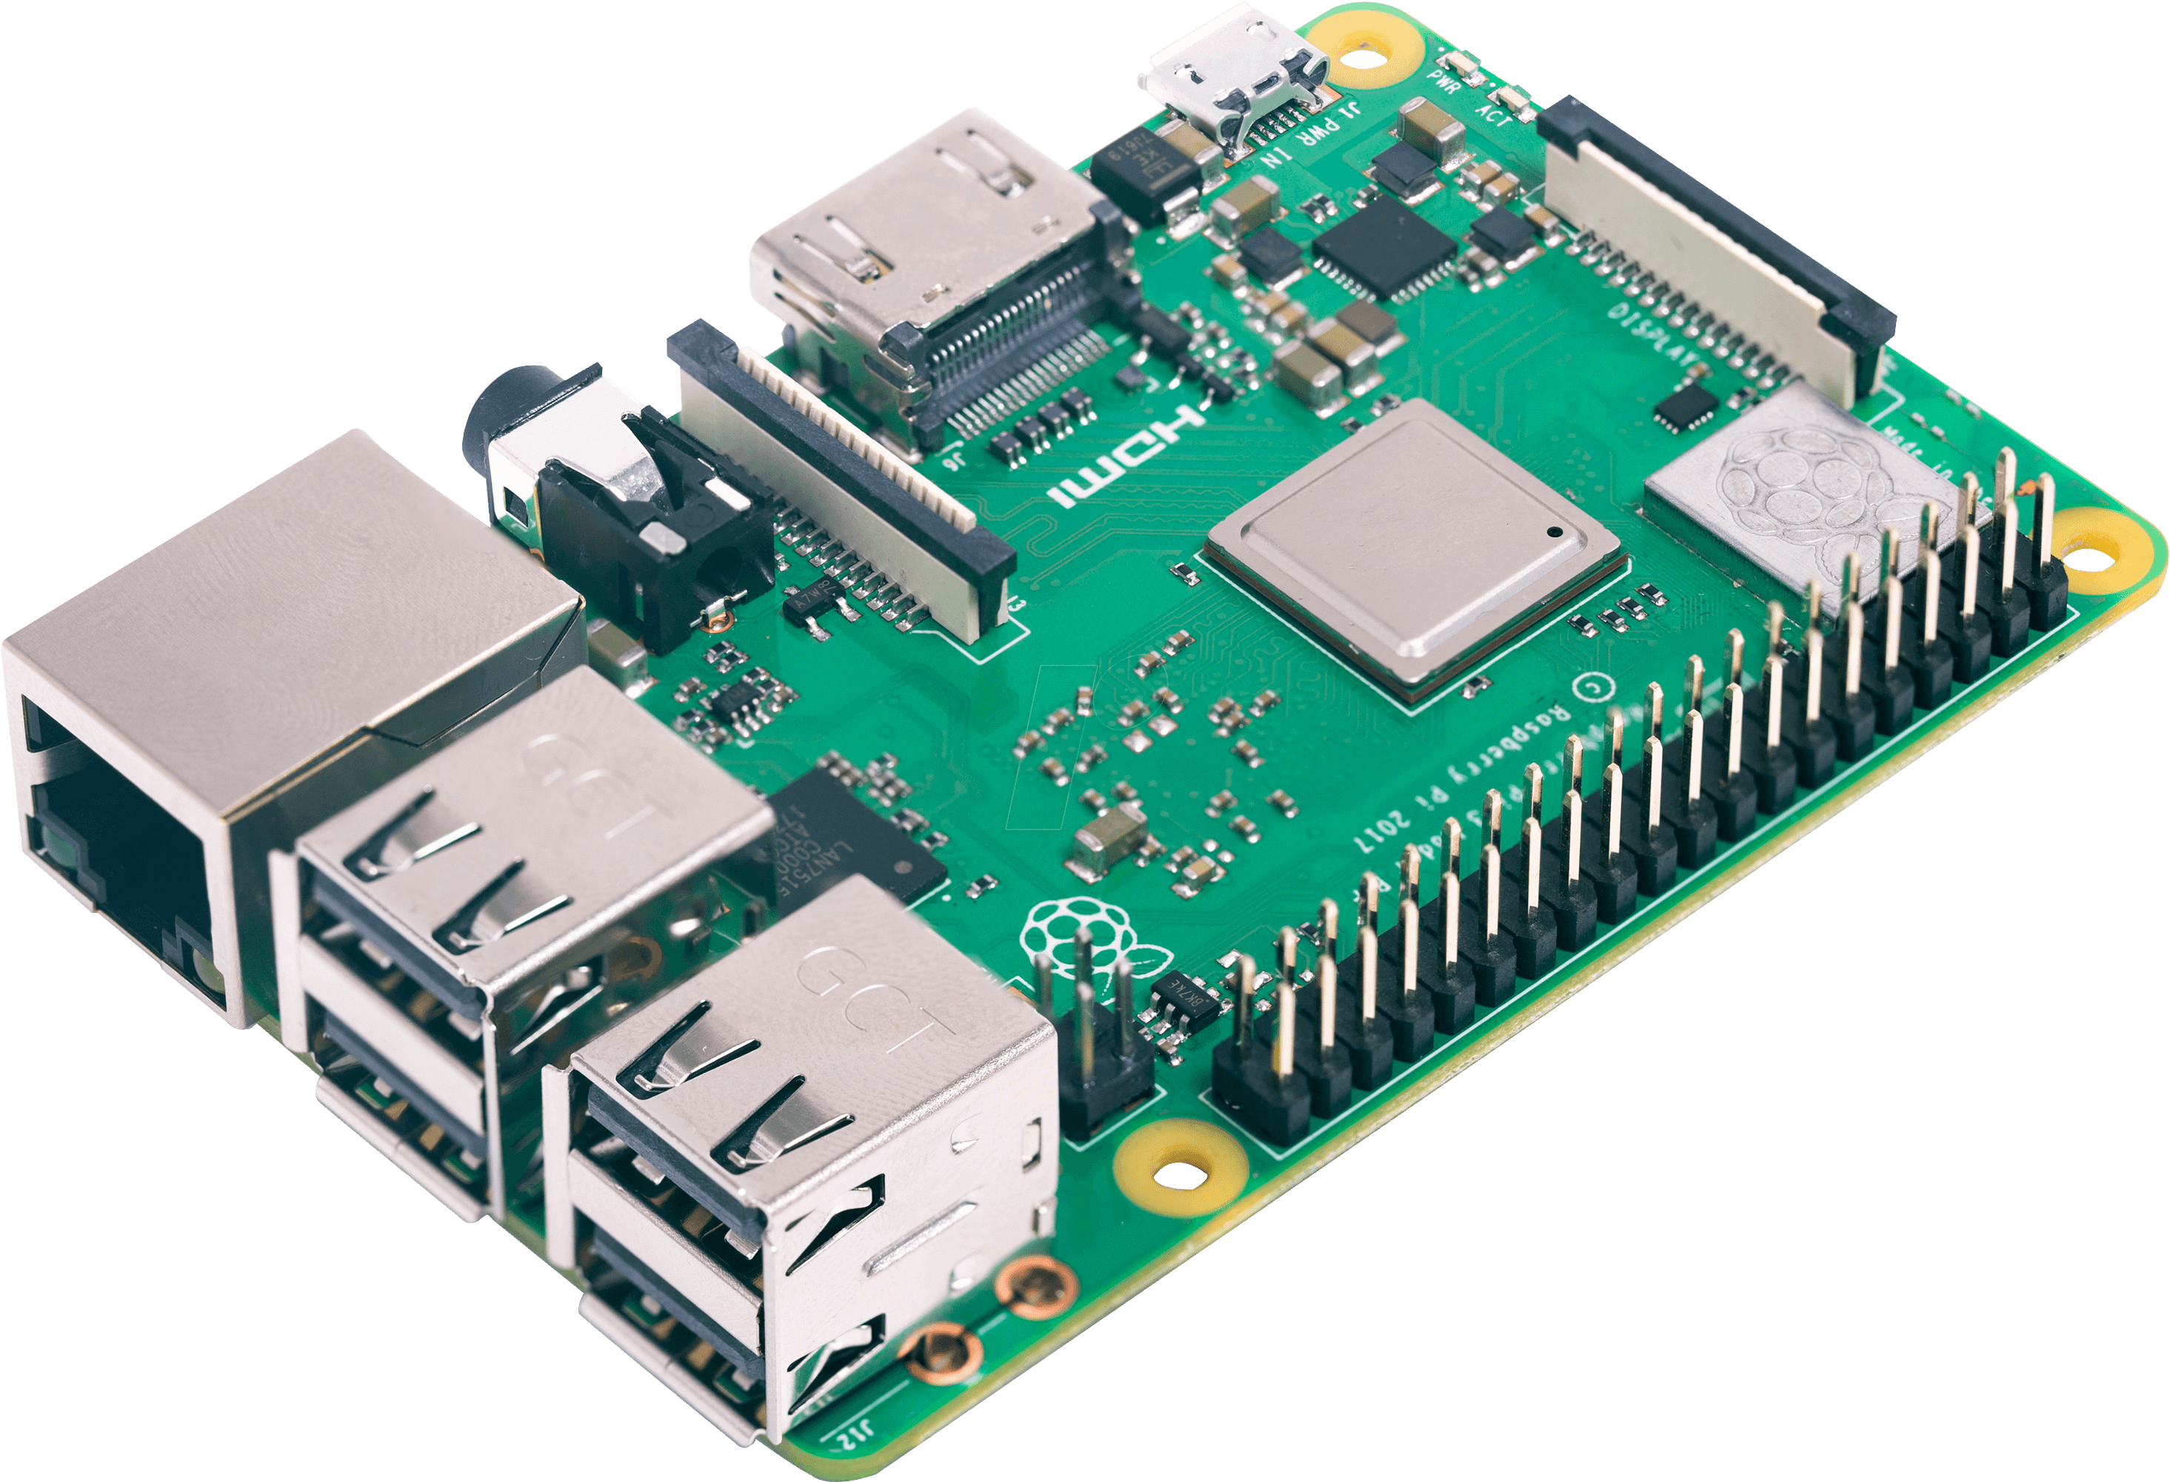
Our implementation
The aim of our project was to implement one attack on a real-world platform. We chose:
Spectre: conditional branch misprediction
Raspberry Pi 3 model B: ARM Cortex-A53
Figure taken from: https://meltdownattack.com/
Figure taken from: https://www.pngaaa.com/detail/2839047

Slide 21
Inside the Raspberry Pi 3B
First, let’s see in detail the parts of the system that we’ll need to interact with during the attack:
Cache memory
Branch History Registers
Pattern History Tables

Slide 22
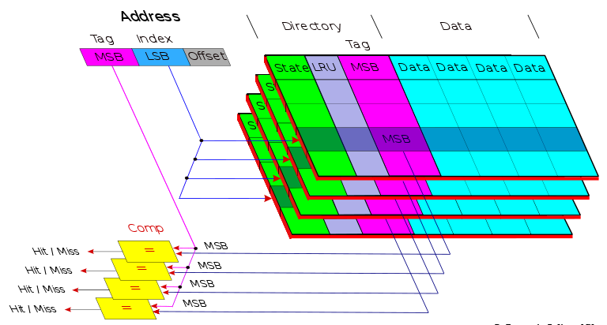
Inside the Raspberry Pi 3B
First, let’s see in detail the parts of the system that we’ll need to interact with during the attack:
Cache memory
Branch History Registers
Pattern History Tables
32KB of L1 cache made up of lines of 64 bytes. L2 cache is present but disabled on our system. The mapping is 4-way set associative and exploits a pseudo-random replacement policy within each set
Figure taken from: https://en.m.wikipedia.org/wiki/File:Set_Associative_Cache.svg

Slide 23
Inside the Raspberry Pi 3B
First, let’s see in detail the parts of the system that we’ll need to interact with during the attack:
Cache memory
Branch History Registers
Pattern History Tables
Abbreviated as BHRs, an array of 3 10-bit shift registers storing the outcomes of the last branches. Each branch operation is mapped to one of the 3 registers by performing the operation: address mod 3
When the outcome of a branch is known, the register content is shifted left and a new bit representing to the branch outcome is inserted as the LSb

Slide 24
Inside the Raspberry Pi 3B
First, let’s see in detail the parts of the system that we’ll need to interact with during the attack:
Cache memory
Branch History Registers
Pattern History Tables
Abbreviated as PHTs, an array of 3 tables of 1024 elements each. Each BHR corresponds to one PHT. The elements of the PHTs are 2-bit saturating counters in which the LSb implements a confidence level (strong/weak) related to the outcome of the branch (taken/untaken) stored in the MSb

Slide 25
The Attack: Background
For the Spectre attack to work we must focus on the following characteristics:
The address of the branching instruction points to a specific BHR register and a specific PHT table
The entry of the chosen PHT is determined by the function branch_addr ⊕ BHR_{branch_addr} so the BHR value must be forced to a known value
The value of the specific PHT entry accessed decides the prediction of the branch, so it must be forced to a known value

Slide 26
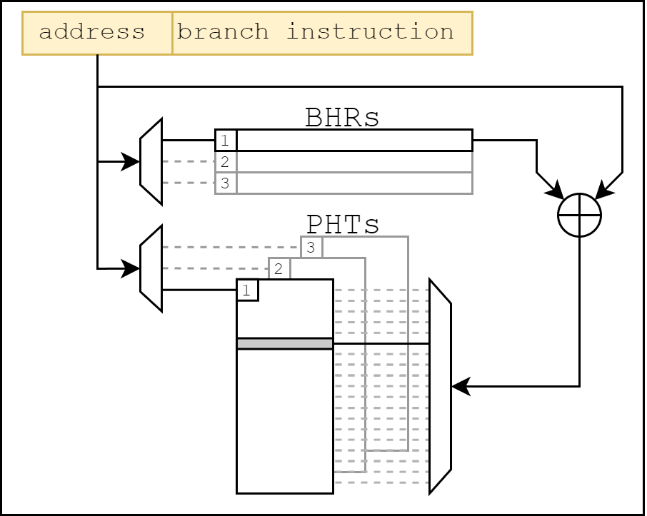
The Attack: Background
The dependency of the previous blocks can be visualized in this diagram:
The BHR and PHT are selected by the address of the branch instruction (mod 3)
The entry in the selected PHT is calculated thanks to the address and BHR

Slide 27
The Attack: Setup
The first step is to set the contents of the BHR and PHT related to the branch address to the needed values to carry out the malicious cache read:
The BHR with unknown content, is overwritten to an all-zero value by calling the victim code 10 times. The result is BHR_{branch_addr}= 0x00
At this point, the PHT entry can be easily identified: branch_addr ⊕ BHR_{branch_addr} = branch_addr
3 more calls are needed to migrate the value of the PHT entry from state 11 (strongly taken) to the state 00 (strongly untaken)

Slide 28
The Attack: Setup
The Branch Prediction Unit is now poisoned but that’s not enough:
The cache is now flushed of the values that would disrupt the branch prediction speculation
An additional 10 dummy instructions are called to make sure that the contents of the BHR weren’t altered during the cache flush

Slide 29
The Attack: Execution
At this point the setup phase is complete and the Spectre attack can be executed:
The malicious code reading the secret data is called
Thanks to the value of the BHR and PHT, the wrong prediction is made
Thanks to the cache flush, the mispredicted branch has enough time to access the secret data
The secret data is retrieved and used to modify the cache

Slide 30
The Attack: Recovery
The attack is almost complete, the attacker can now retrieve the secret data thanks to a timing analysis:
The performance timer is started using the function rdtsc32()
The cache lines are accessed
The performance timer is stopped
By calculating the time taken to access the cache data, the secret data can be discovered

Slide 31
The Attack: What else?
Our implementation of the attack works well only on a single-core system. This is because of the lack of multiple layers of the cache.
We managed to create an additional attack aimed at a multi-core system with an additional constraint:
The process must be bound to a specific core for the attack to work correctly

Slide 32
The Attack: What else?
Unfortunately, the multi-core attack just mentioned is not successful as the single-core described before:
The setup, similar to the single-core version, goes as planned
The cache read works correctly
The speculative access to the data fails
The exact nature of this issue is unknown and further research and testing are needed

Slide 33
Setup of the lab environment
Some preliminary steps are required for the experience (all the code is provided in a folder):
Install an OS with memory protection on the Raspberry (Raspbian) or build a custom image using Poky
Set the CPU clock speed to a fixed value and adjust the memory frequency (1 GHz both, it also works with different settings and dynamic memory settings)
Install a kernel module to abilitate access to PMU from thread mode (EL0) (add it to /use/lib/$(uname -r)/kernel/..., add its name to /etc/modules/module.conf, run "sudo dmprobe", make sure the module can be loaded manually using modprobe)
Retrieve the code from the folder that we provide and compile it using the makefile included
Adjust the alignment of the dummy branches in the code by inspecting the objdump of the project: make sure that you insert a number of NOPs before the dummy branches such that the address of the first branch modulo 3 is equal to the address of the branch in the victim code modulo 3
To play a bit with the code: try to add some strings after array1 (or change the contents of string s) to see if they are read!

Slide 34
Self evaluation exercises (1)
Try to replicate the original Spectre attack in ARM by replacing the code in the victim with:
LDR X5,[X0]
CMP X4,X5
BGE wrong_x
LDRB W1,[X1,X4]
AND X1, X1, X7
LSR X1, X1, X3
LSL X1, X1, #12
LDRB W2,[X2,X1]
(in this way we are putting both levels of memory accesses inside the speculation, thus replicating the idea of the original Spectre)
Does the code work? Why or why not?

Slide 35
Self evaluation exercises (2)
Try to change the following characteristics of the code and comment the results obtained:
Number of mistraining cycles : choose a number greater than 13 and another one smaller, what happens in the two cases?
Number of alignment NOPs
Level of optimization for the compiling process
Try to increase the operations done inside the speculation (for example by adding some unoptimized NOPs): does the code still work or the time is not enough for the read from memory to happen?

Slide 36
Self evaluation exercises (3)
Try to implement a mechanism able to read multiple bits from the selected bytes. This requires another strategy, different from the one we've explained during the experience (the one able to read only one bit).
Hint: try to randomize the accesses within a single memory page, so that the prefetch algorithm can't keep track of the accessed lines. If possible, try to find a better randomization algorithm than the one presented in the paper.

Slide 37
Self evaluation exercises (4)
Try to find an attack able to measure the access latency that avoids creating misses. Among the ones that are possible there is the Flush+Flush, introduced as one of the possible attacks for implementations of Spectre.
Try to implement another attack among the ones described in the Spectre paper, paying attention to which of them are applicable in the Raspberry architecture.

Slide 38
Self evaluation exercises (5)
Try to change prefetcher settings by modifying CPUACTLR_EL1 (it must be executed after a reset and before the MMU is enabled, you need to change settings in the boot sequence). Try to change the number of bits read in each iteration of the attack to check the effects on the prefetching.
Is it possible to increase the number of bits read if we increase the length of the stride that triggers prefecthing?
What happens if we completely disable prefetching?

Slide 39
Conclusions
We illustrated the theory behind two powerful hardware-based attacks:
Meltdown
Spectre
We successfully implemented a Spectre attack exploiting the conditional branch prediction on a widely used real-world platform:
Raspberry Pi 3 model B

Slide 40
THE END
Thank you for your attention

